Slide 1


The key to become the ultimate fighter

Slide 2
01
04
02
05
03
What is the UFC?
Predicting a fight?
Short introduction about the UFC competition and its impact on the world
Can machine learning predict the winner of a UFC combat?
Fighters
Conclusion
Analysis of the most relevant attributes that describe a fighter
Discovering the key attributes that make a fighter the ultimate champion
Fights
Analysis of the most important variables when it comes to winning a match

Slide 3
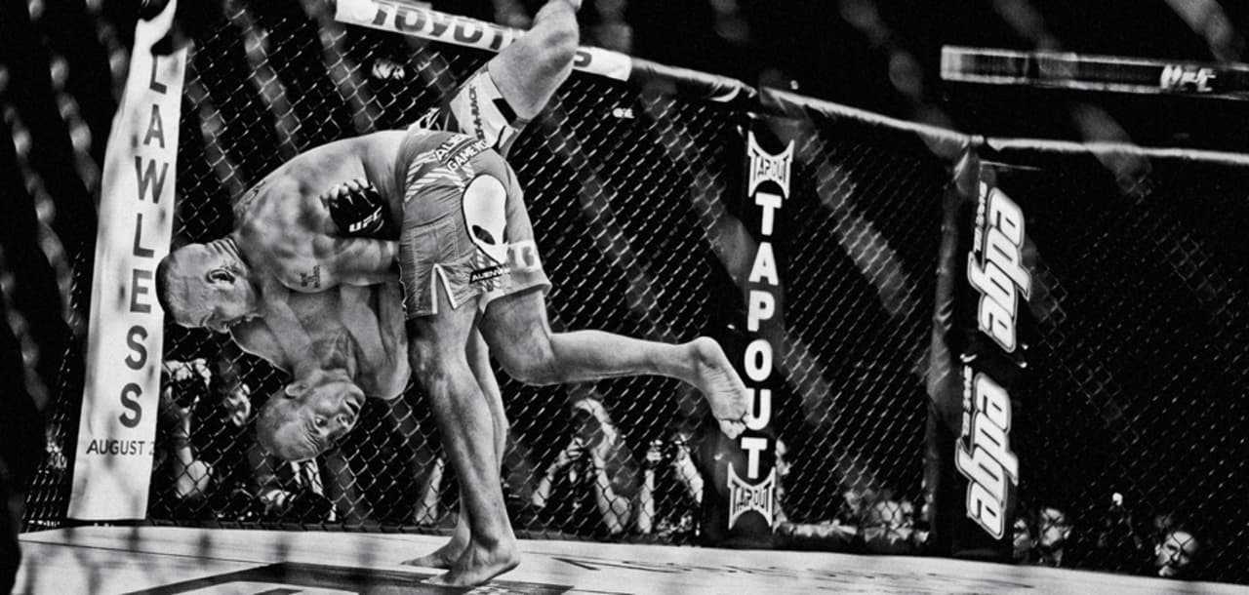
What is the UFC?
01

Slide 4
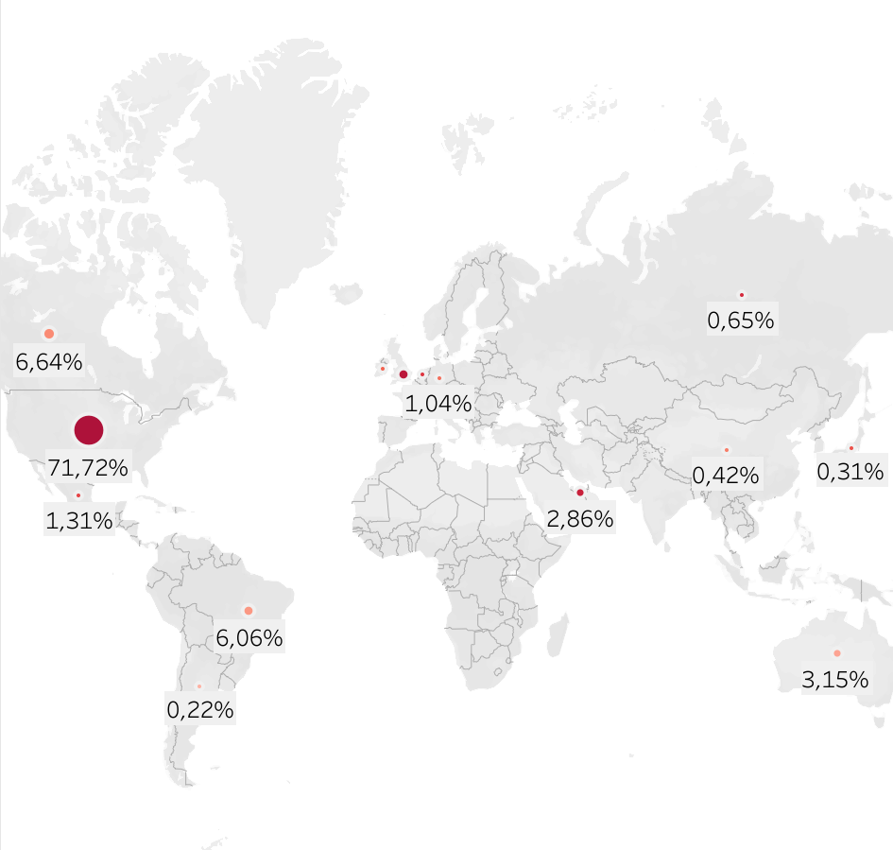


What is the
01
Where does it take place?:
Global fan base:
2020
330 million fans*
28,9 M followers
33.1 M followers
*Estimation based in revenue growth
Notes:
The Ultimate Fighting Championship (UFC) is an American mixed martial arts (MMA) promotion company. The best fighters of the planet compete in the UFC

Slide 5
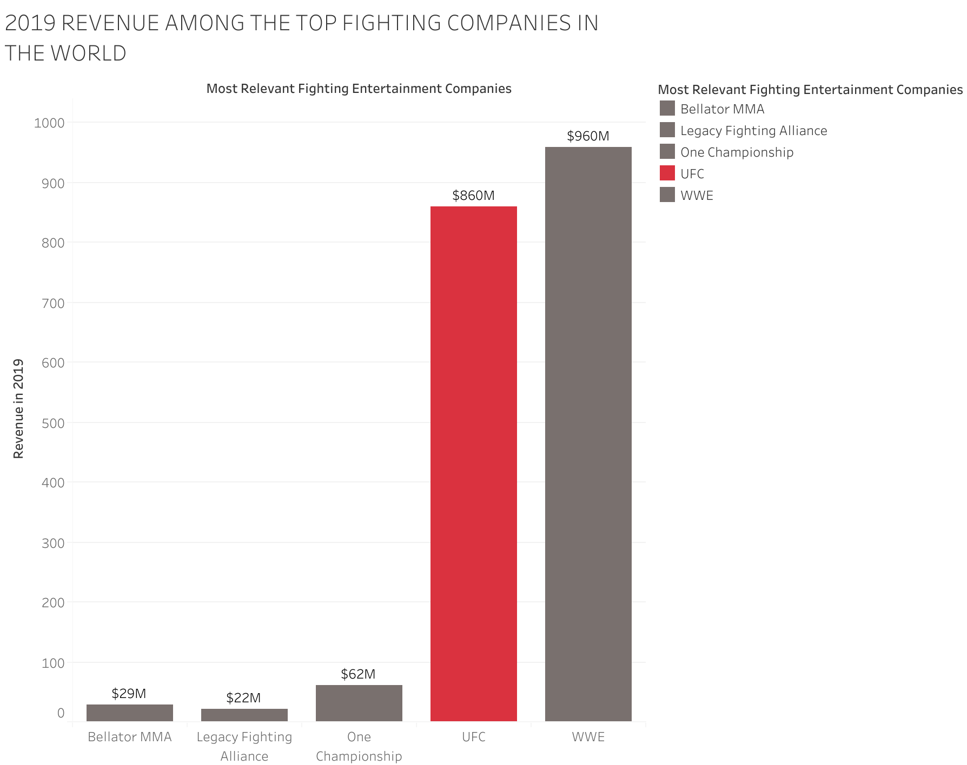
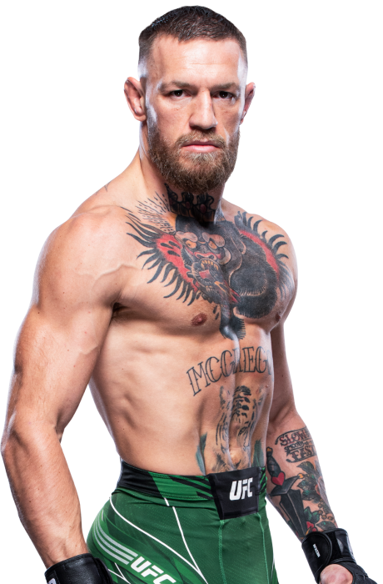
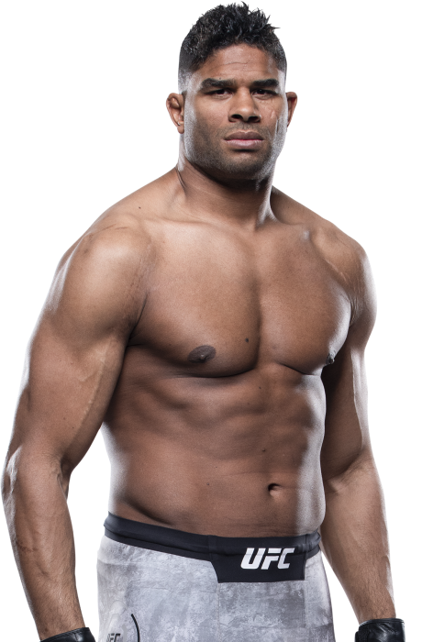
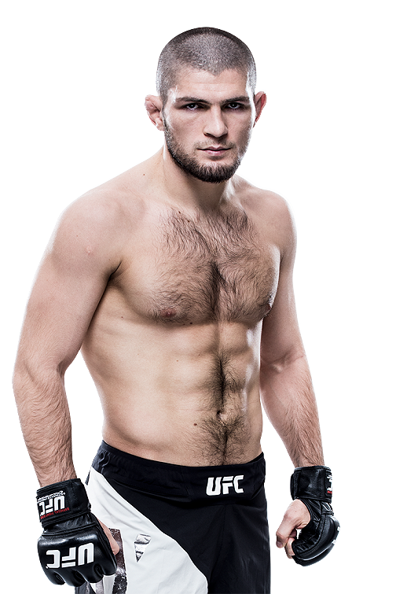
What is the UFC
01
Most relevant Fight Companies in 2019:
Avg. UFC fighter salary in 2020:
$ 147.965
TOP 3:
1
Connor McGregor
$15 M
2
Alistair Overeem
$9.6 M
3
Khabib Nurmagomedov
$8.7 M
Source: Yahoo Finance, 2021

Slide 6
Fighters
02

Slide 7


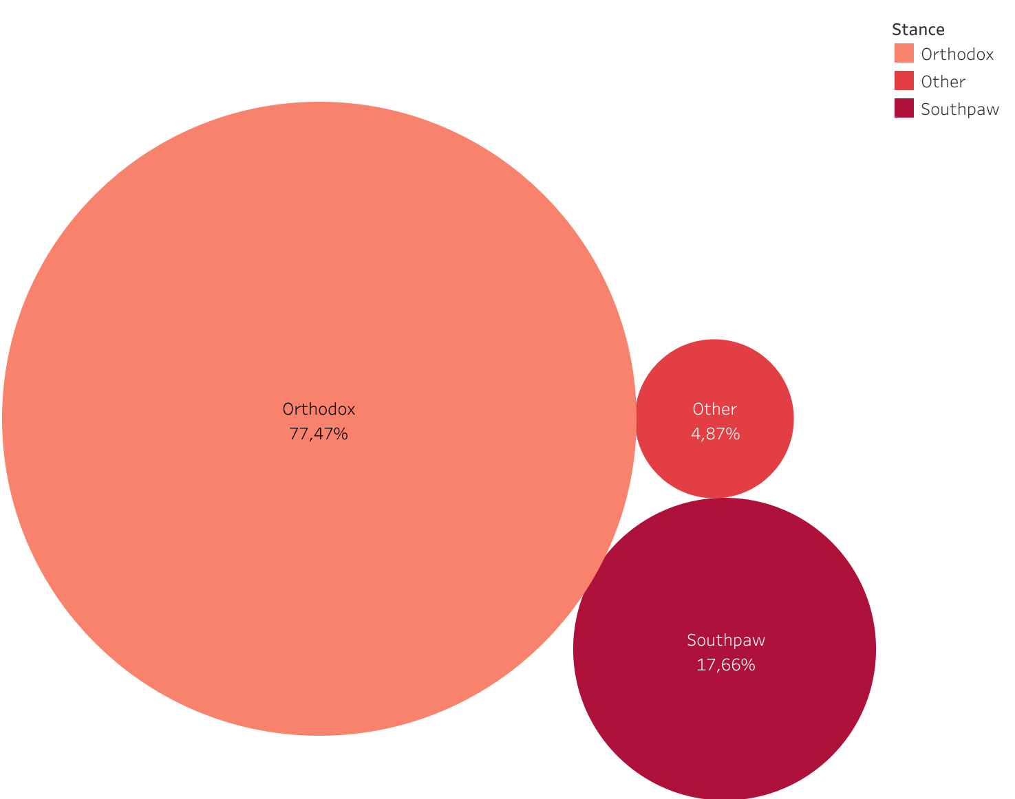
Fighters
02
92%
Most common fighters' stance
8%
Height
1.78 m
Weight
164 lb
Reach
1.82 m

Slide 8
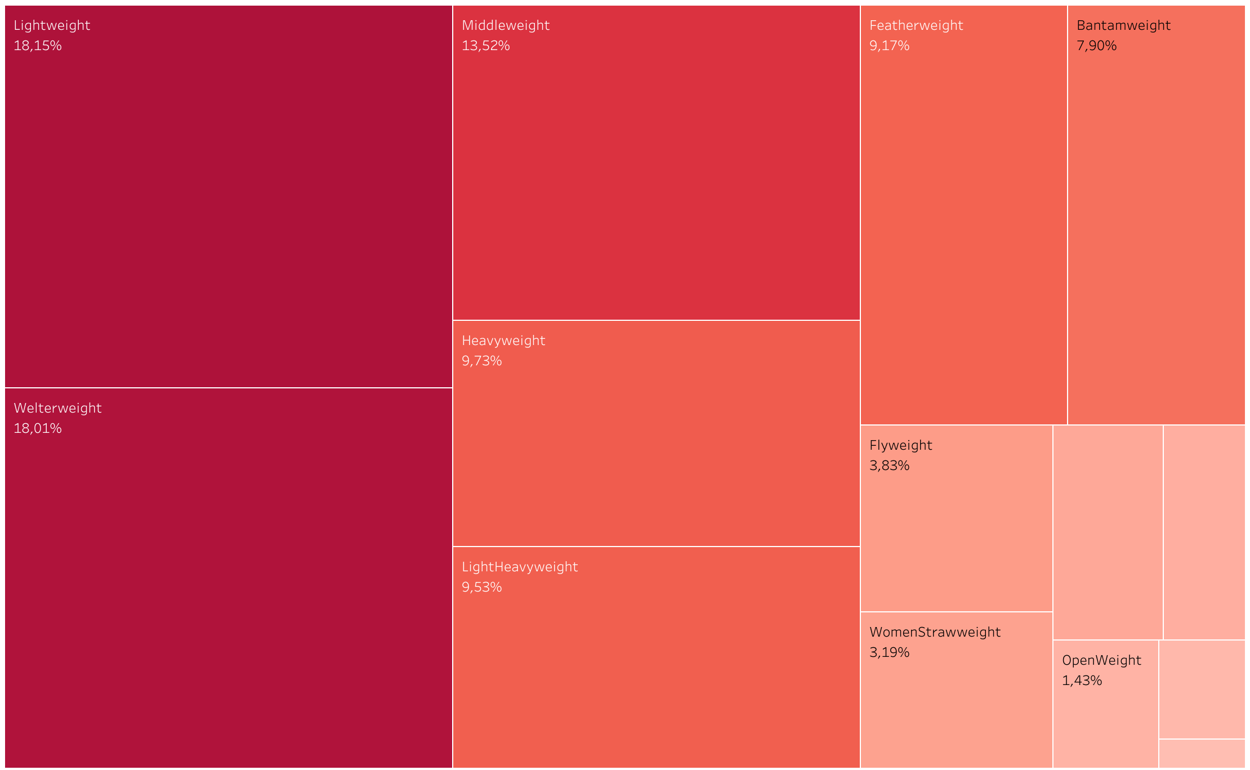
Fighters
02
Percentage of fighters per Weight Category

Slide 9
Fights
03

Slide 10
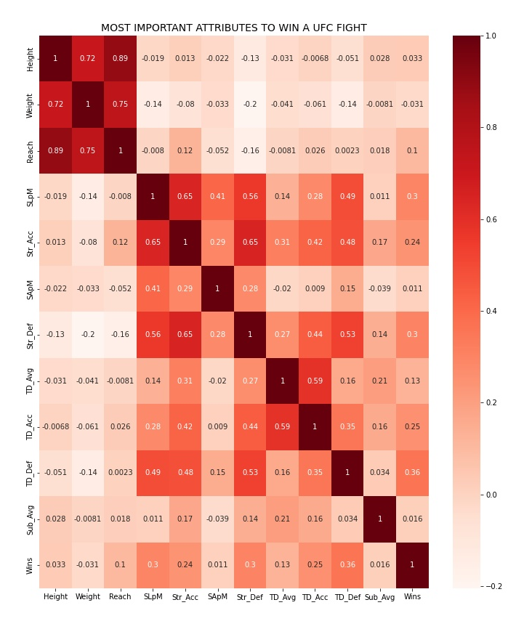


Fights
03
Takedown defence
The percentage of takedowns that you defend is the principal key to win a UFC fight nowadays.
Striking defence
The more hits you can defend, the more likely you are to win a UFC fight.
Significant landed punches
Not all is defending! If you are as precise as a sniper with your punches, Your chances of victory increase!

Slide 11
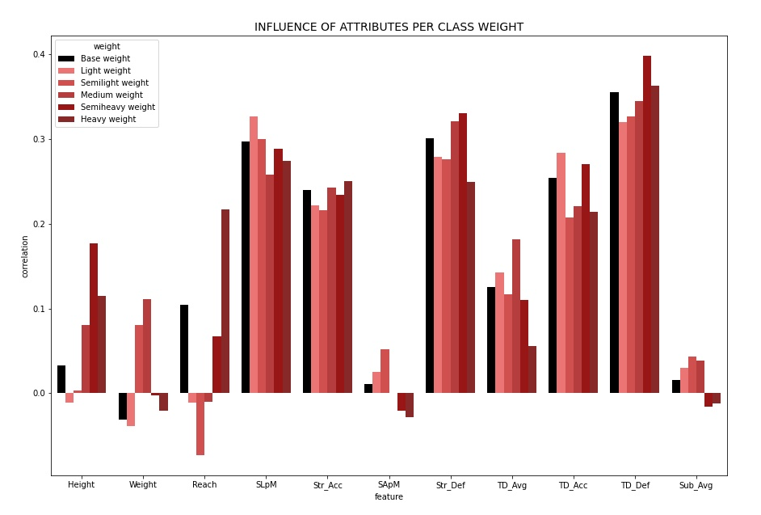
Fights
03
Semiheavy
Light (105 -145) | SLpM and TD_Acc
Semilight (145-155) | SApM
Medium (155-170) | Weight and TD_Avg
Semiheavy (170-205) | Height, Str_Def and TD_Def
Heavy (>205) | Reach, Str_Acc
Light
Semiheavy
Light
Heavy
Heavy
Semiheavy
Medium
Medium
Semilight
Medium

Slide 12
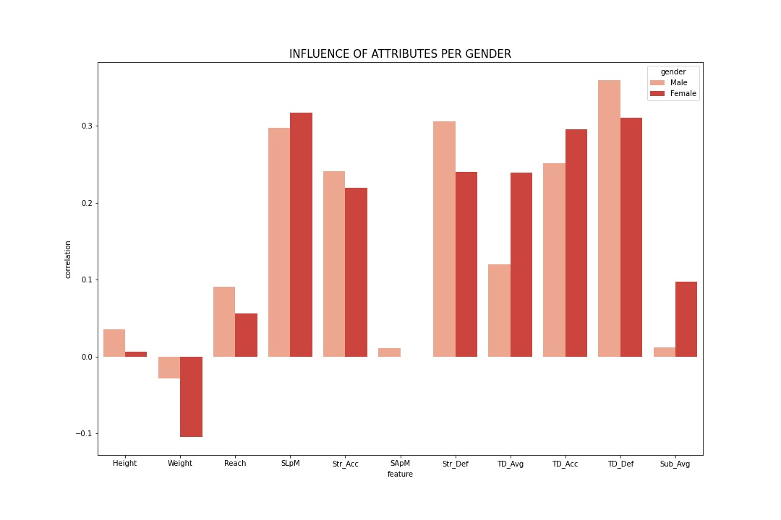
Fights
03
MALE
Height
Reach
Str_Acc
SApM
Str_Def
TD_Def
FEMALE
Weight
SLpM
TD_Avg
TD_Acc
Sub_Avg

Slide 13
Predicting an UFC fight?
04

Slide 14
Predicting a UFC fight?
04
Filter numerical variables > 0.1 correlation (144 to 24)
Drop features that generates multicollinearity (24 to 5)
Perform X-Y and Train Test Split
Fill NaN values and scale all the variables
Fit a logistic regression model
Extract and evaluate the results
Balance the classes of the target
Extract and evaluate the new results
Input variables
Significant strikes received
Significant strikes landed
Ratio of losses
Ratio of winnings by DS
Age

Slide 15
Predicting a UFC fight?
04
RESULTS NOT BALANCED DATA
RESULTS BALANCED DATA
Accuracy
Accuracy
0.66
0.61
Recall
Recall
0.47
0.43
F1
F1
0.21
0.49
Precision
Precision
0.14
0.57

Slide 16
Conclusions
05

Slide 17





Conclusions
05
1. TAKE DOWN DEFENSE
4. WEIGHT CATEGORY CAN INFLUENCE THESE VARIABLES
5. GENDER MAY SLIGHTLY VARY THE RELEVANCE OF THESE ATTRIBUTES
2. STRIKING DEFFENSE
3. SIGNIFICANT LANDED PUNCHES PER MINUTE
6. We can not demonstrate that the next variables have not relation: Height vs Reach, TD_Def vs wins and Sub_Avg vs TD_Acc
HYP

Slide 18
Conclusions
05
NEXT STEPS:
Carry out a more in-depth study on the ufc and its industry : growth drivers, revenue rates, internationalization...
To deepen the study of fighters’ attributes by creating distributions by category and gender
Analyze other variables that may influence the victory such as the nationality of the fighter, the stance or the place where the fight takes place
Try to improve the model with other parameters and approaches. Try and test other models and compare the metrics.

